Slide 1


Slide 2
Brief Synopsis
Whenever Data Scientist create some model or do prediction before that they need to do some data pre-processing steps, it include handling missing data, feature scaling, data deduplication, visualization to understand data more effectively but it’ very time consuming that’s why we are creating one Eda tool which can make their job easy.
Eda tool is implemented on Pyspark because when we work on Bigdata we want some powerful engine to process data fast and Pysaprk uses spark engine to process data and I think it’s the best solution for Bigdata problem. Apart from Pyspark I am using flask framework to implement this app. For the future purpose I’ll try to use some cloud platform to deploy it.

Slide 3
Technology/Tool/Stack
Programming Language : Pyspark
Python application Framework : Flask
Front-end Technology : HTML

Slide 4
Solution Architecture
It’s a Pyspark Powered EDA Tool . It’ll provide basic stats like shape of Data Frame, Quantile and Interquartile range, mean , max , min , standard Deviation, count of column . It’ll also break date column into month, day, year. Apart from these visualization is also there for missing value , correlation , time series , simple bar and box plot to understand the data clearly.
Limitations :
You can analyze one file at a time. So if you want to analyze multiple file you first have to merge them and after that you can upload it and it’ll provide you EDA.
As of now it’ll read only csv and txt data and in the future ill also try to read json file.

Slide 5
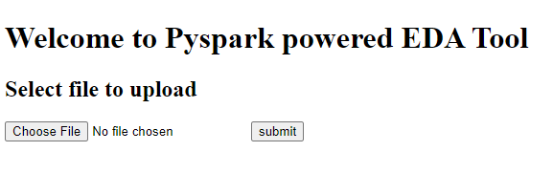
Prototype/ MVP Demo Video/Screenshots
EDA Tool Screenshot for all the UI Pages
1. It’s a home page of application. Here user can upload csv file to perform Eda.

Slide 6
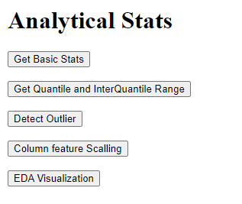
Prototype/ MVP Demo Video/Screenshots
EDA Tool Screenshot for all the UI Pages
2. Once you uploaded your csv file it’ll show you all the option you can perform through this application.
Basic stats will give you shape , mean min standard max and count for all the column.
When user click on quantile it’ll show you quantile value and interquartile range foe all the column
Through Feature scaling you can convert date column into month day and year and format of date should be dd.MM.yyyy
Eda Visualization you can further explore

Slide 7
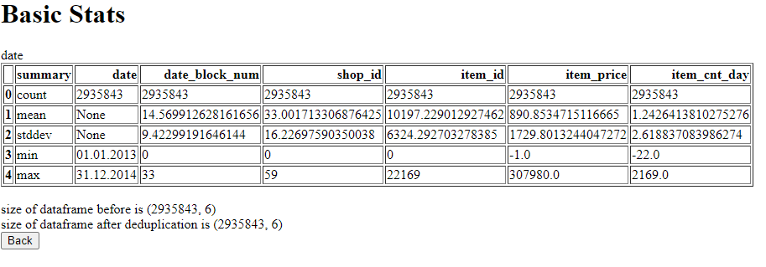
Prototype/ MVP Demo Video/Screenshots
EDA Tool Screenshot for all the UI Pages

Slide 8
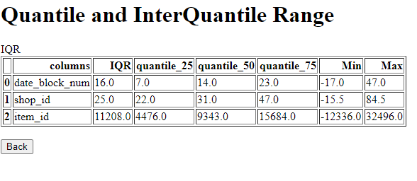
Prototype/ MVP Demo Video/Screenshots
EDA Tool Screenshot for all the UI Pages

Slide 9
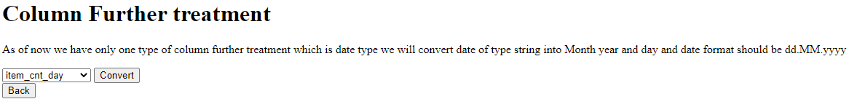
Prototype/ MVP Demo Video/Screenshots
EDA Tool Screenshot for all the UI Pages
3. When you click on column further Scaling it’ll give you the drop down list but you need to select only date column if you want to convert it’ll automatically add conversion column in your data frame

Slide 10
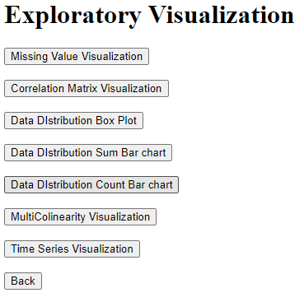
Prototype/ MVP Demo Video/Screenshots
EDA Tool Screenshot for all the UI Pages
4.When you click on exploratory Visualization you will get all the option you can perform visualization on dataset
Note: Multicollinearity and outliers visualization is not working right now . It’s in progress.

Slide 11
Challenges Faced
Challenges:
Performance: the main challenge I am facing here to improve performance because file on which I am trying to Perform EDA is 90 MB in size it’s not that much big still its taking time.
Visualization: Using Pyspark we cant perform visualization without any cloud platform so here I need to convert all the spark data frame to Pandas Data frame and that’s why performance degraded a bit.

Slide 12
Future enhancements
1
Cloud Platform Integration
I’ll try to integrate application to cloud perform so that performance of the app will increase.
Better Visualization
2
As of now Visualization is not that much efficient so ill try to improve it in future enhancement.

Slide 13
Thank You

